Slide 1


Paris Olympic Games 2024 Power BI Dashboard
The purpose of this dashboard is to analyze and monitor the performance of different countries in the Olympic Games, across event categories and over time. We want to identify trends in medal counts, highlight which nations are improving or declining, and provide actionable insights for sports administrators to decide where to invest in training and development.
Presented by Sanjay S N

Slide 2




Comprehensive Data Integration
To address the challenge of dispersed Olympic data, we've integrated information from several key sources into a cohesive Power BI model. This strategic approach ensures that all relevant data points are harmonized for comprehensive analysis.
Olympic Games Medal Tally
Athletes Dataset
Detailed records of country, gold, silver, bronze, and total medals.
Information on athlete name, country, gender, age, sport, event, and medal won.
Country/Region Dataset
Historical Dataset
Mapping NOC codes to country names and continental regions.
Tracking annual medal counts by year and country for historical analysis.

Slide 3

Dashboard Overview: Key Performance Metrics
Our interactive dashboard provides an immediate snapshot of the Olympic landscape, highlighting critical statistics and top performers at a glance.
11,110
326
Total Athletes
Total Gold Medals
Diverse participation across all events.
Reflecting peak athletic achievement.
92
801
Winning Countries
Medal-Winning Athletes
Global distribution of medal success.
Individual excellence recognized.
Leading the Charge: USA Dominance
The United States stands out as the top-performing country based on overall medal count, showcasing consistent excellence across various sports. The dashboard visually represents this global distribution of success.

Slide 4

Medals by Country: Global Powerhouses and Gender Performance
This section of the dashboard zeroes in on national medal achievements and offers a crucial comparison of gender-specific athletic dominance across various disciplines.
Top Performing Nations
USA, China, France, Great Britain, and Australia consistently lead the medal tally, demonstrating strong national athletic programs.
Gender Performance Insights
Male athletes excel in sports like Athletics and Swimming, while female athletes show significant strength in Judo, Wrestling, and Artistic Gymnastics.

Slide 5

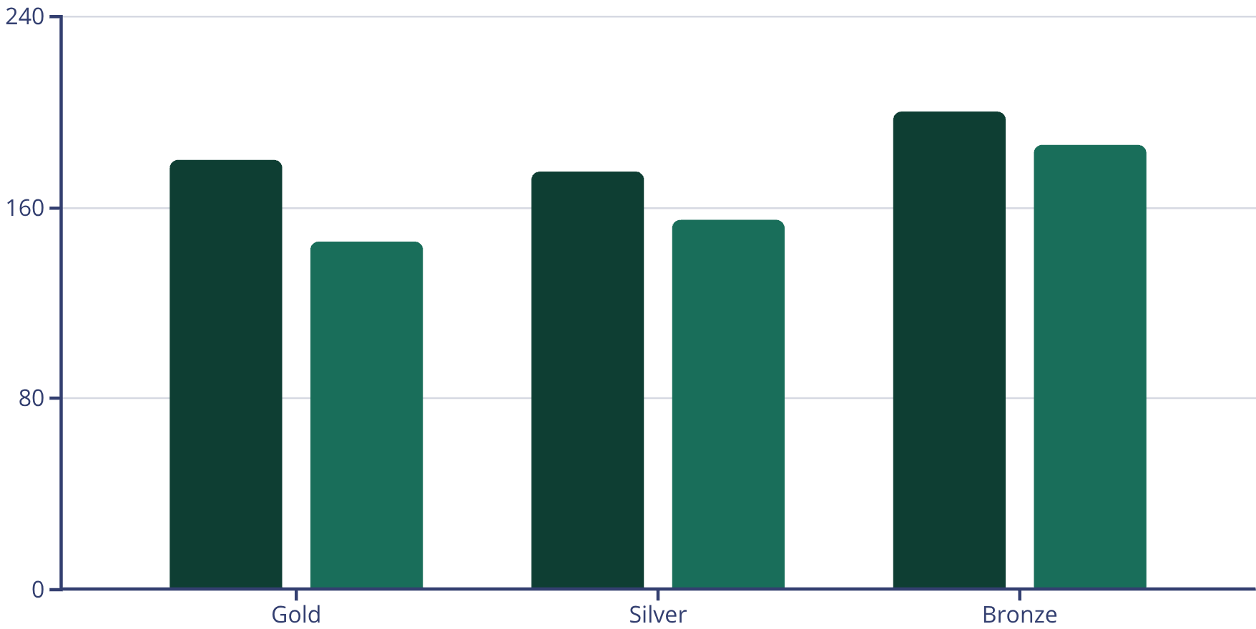
Athlete Analysis: Demographics and Medal Contribution
The Athletes Page provides a deep dive into participant demographics, offering insights into age distribution, gender balance, and country-specific medal contributions from individual athletes.
Leading Medal-Winning Nations
USA, France, Australia, and Germany account for the highest number of individual medal-winning athletes, showcasing the depth of talent in these countries.
The dashboard clearly compares male versus female medal contributions across Gold, Silver, and Bronze categories, highlighting gender-specific strengths.
Male
Female
Age and Gender Distribution
The highest athlete participation falls within the 21-26 age bracket, reflecting peak physical performance years. Gender distribution is remarkably balanced, with 5655 male and 5455 female athletes.

Slide 6

Historical Trends: Tracking Enduring Excellence
The Historical Page is designed to showcase the evolution of Olympic performance over time, revealing long-term patterns and highlighting countries with sustained success.
Year-by-Year Medal Evolution
Visualize the ebb and flow of Gold, Silver, and Bronze medals across different Olympic years.
Identifying Consistent Performers
Analyzing Performance Peaks & Declines
Pinpoint nations that have consistently excelled over multiple Olympic cycles.
Uncover periods of exceptional performance or downturns for individual countries.

Slide 7
Future Scope: Enhancing Predictive Analytics and Deeper Insights
Our Olympic Games Dashboard is continuously evolving. Future enhancements will focus on incorporating advanced analytical capabilities to provide even richer insights.
1
Predictive Analytics
Implement models for forecasting future medal winners and national performance trends.
2
Economic and Demographic Metrics
Integrate medals per capita and medals per GDP to provide a broader context for national success.
3
Athlete Performance Progression
Track individual athlete performance across multiple Olympic appearances to identify career trajectories.
4
Host-Country Advantage Analysis
Explore the impact of hosting the Games on national medal counts and athletic performance.
5
AI-Powered Insights
Develop AI-based systems for player comparisons and to calculate medal probability scores.

Slide 8

Conclusion
The Olympic Games Dashboard stands as a powerful tool for understanding the intricate world of athletic competition. By centralizing and visualizing diverse data, it transforms raw numbers into compelling narratives of triumph and effort.
This dashboard offers a complete 360° view of athlete distribution, country performance, medal counts, and historical trends. It serves as an invaluable resource for analysts, sports researchers, Olympic committees, and enthusiasts seeking to explore Olympic performance in an interactive and meaningful way.
.

Slide 9
Thank you

